Slide 1

KHATRA ADIBASI MAHAVIDYALAYA
E-CONTENT
DEPARTMENT OF EDUCATION
SEMESTER-V (PROGRAMME)
SESSION: 2018-19
SUBJECT: EDUCATION
COURSE TITLE: DEVELOPMENT OF EDUCATION I INDIA
COURSE CODE: AH/EDN/404/GE-4A
TOPIC: INDIAN EDUCATION COMMISSION (1964-66)
NAME OF THE TEACHER: AKINCHAN PAL

Slide 2
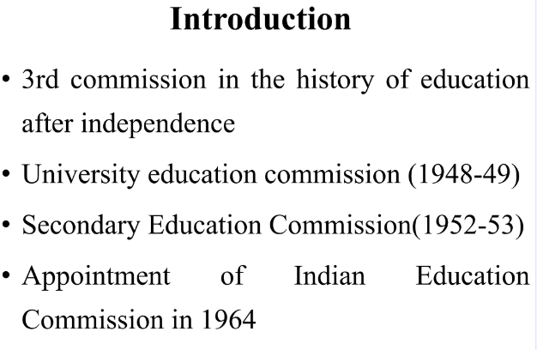
Indian Education Commission (1964-1966)

Slide 3
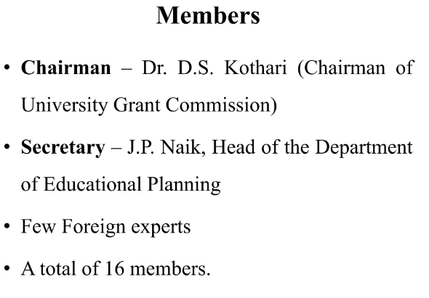

Slide 4
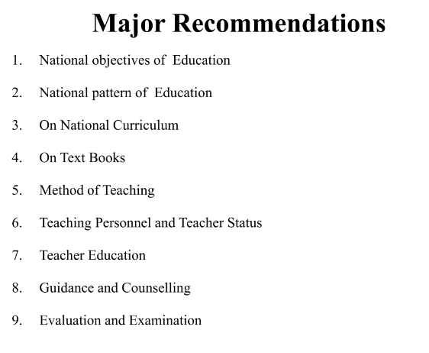

Slide 5
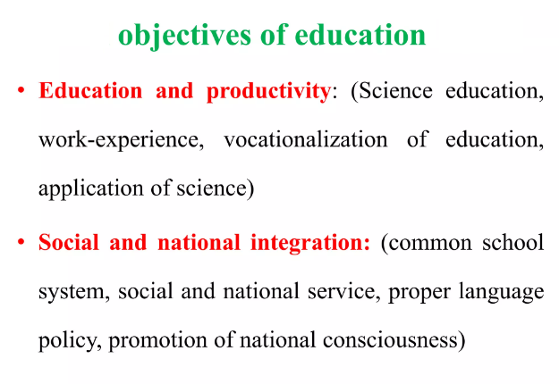

Slide 6
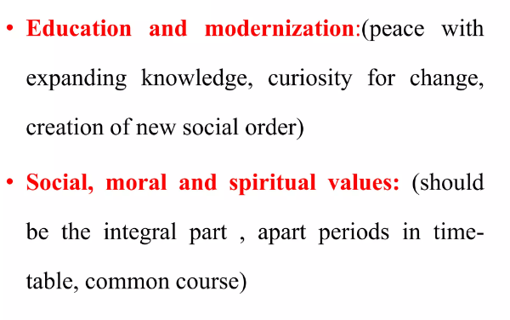

Slide 7
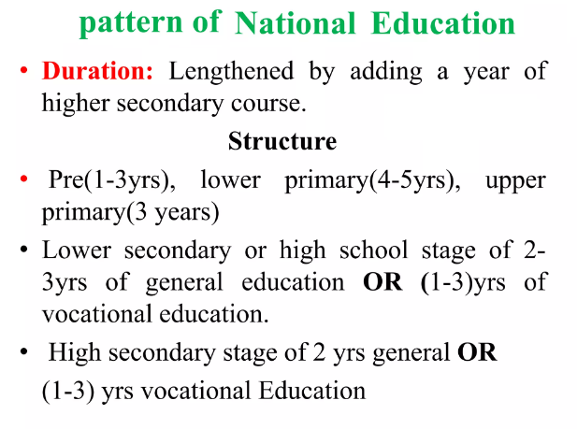

Slide 8
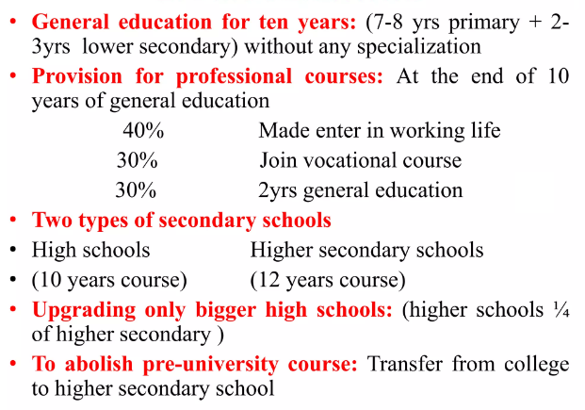

Slide 9
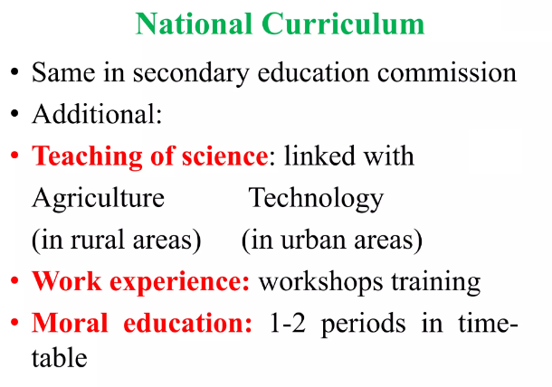

Slide 10
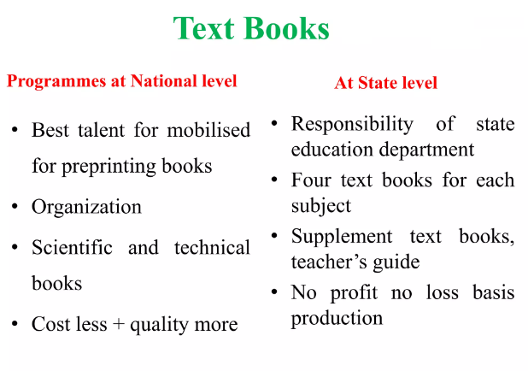

Slide 11
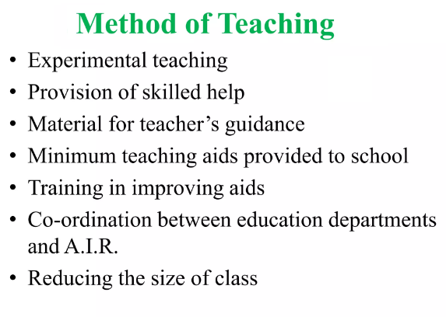

Slide 12
THANK YOU

